Slide 1

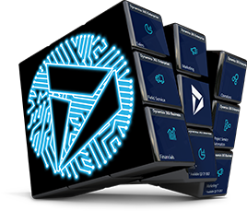


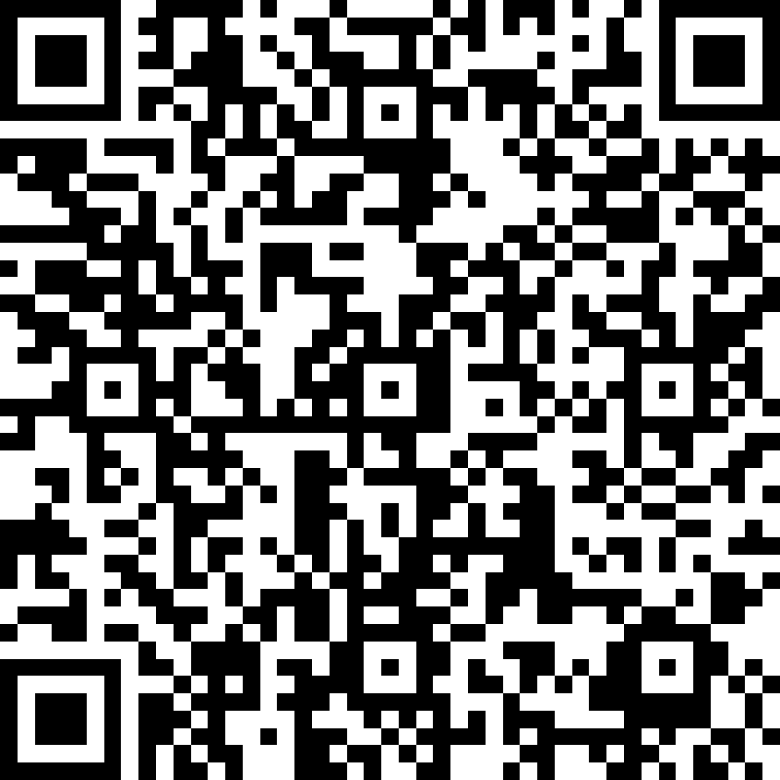
Building a PowerApp in an hour

Slide 2

Social
www.365portal.org
Twitter: @Dyn365Community
Linkedin: @365-Saturday
Hashtags
#D365SaturdayVictoria #365Saturday #msdyn365
Wifi: TBC
Pass: TBC
Community.Dynamics365.com

Slide 3


Dynamics 365 Community
Join the Dynamics 365 Community, where you can interact with your peers and Microsoft Dynamics 365 experts. You can get answers to your questions by posting questions in the forums, starting discussions, reading informative blog articles, and watching how-to videos.
https://community.dynamics.com
Benefits
Participate and help build a pool of knowledge that’s accessible by members at any time!
Expand your network by engaging with peers
Involvement
Need help? Ask questions and join in on business or technical discussions in the forums
Share your expertise by hosting a blog or syndicating your existing blog
Recognition
Earn badges for participation and engagement
Become a Community Star and earn appreciation from peers
Join Today!
Get answers, find inspiration, connect with others
Free membership
Any questions? Email us at dlcommed@Microsoft.com

Slide 4
INTRO
Lab mode
Survey – for login credentials
https://aka.ms/AppIn60Mins
Hands-on Lab
Walk-thru so you can follow along
Context

Slide 5

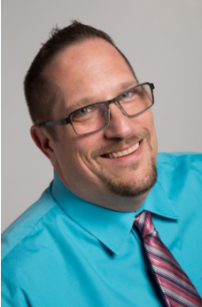








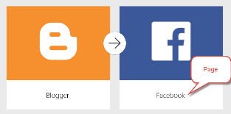
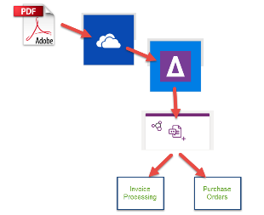




INTRO
Éric Sauvé – Solution Architect
Passionate about the Power Platform and actively sharing to the Business Applications community as @ZePowerDiver
D365 CE & PowerApps Solution Architect
At XRM Vision since 2015
TDGi Community Lead
Power Platform Happy Hour – Montreal founder and organizer
xRM Montreal Meetup Organizer
Sea Diver

Slide 6
LAB TIME

Slide 7
Feedback
We really value your feedback. Log-in to the 365portal event page and click on the session title.
Make sure you have added the session to your schedule and you have checked in.
You can now leave feedback which will help the speaker and improve our future events for the community.

Slide 8
